Slide 1




Data Structure
Double link list
Lecturer: Asst. Prof.Dr. Alaa Ahmed Abbood
Lecture 4.
Class 2nd .
Time: 12:30-2:30
Department: Businesses Information Technology (BIT)

Slide 2


Outline
Doubly Linked Lists.
Drawbacks in singly Linked Lists.
Doubly Linked List components.
Operations On doubly linked List
Inserting at the beginning of the list
Inserting at the end of the list
Deleting from the beginning of the list.
Deleting from the end of the list.

Slide 3
Doubly Linked Lists
As we learnt before, singly linked list is a structure that contains at least two fields, data field and a pointer to the next node. Singly linked lists are flexible structures where memory can be allocated in “small” blocks as needed. Also, when deleting or inserting nodes from a singly linked list, the overhead is relatively low compared to array insertions where array elements have to be moved with a greater cost. This makes singly linked lists (LL) preferred data structures to use in many applications.

Slide 4
Drawbacks in singly Linked Lists
However, one drawback in LL is that list can only be navigated in one direction and all navigations must start from the head node. But imagine an application where nodes need to be inserted quickly, in order, and the data file typically provides clusters of data that needs to be inserted close to each other. It is quite common in data sets to have related data close to each other.
For example, think of a user database where names are almost sorted and therefore needs to be inserted next to each other. In this case, it makes sense for the current pointer to remain in place until the next value is read from the data set. Based on the value of the date set, the current pointer can move forward or backwards to insert data in correct place.

Slide 5
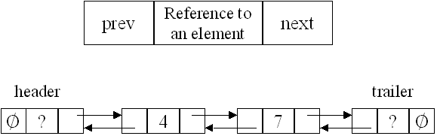
Doubly Linked List
A doubly linked list is a collection of objects linked together by references from one object to another object, both forward and backward. By convention these objects are named as nodes. So the basic DLL is a collection of nodes where each node contains one or more data fields AND references to next node and previous node. The next pointer of the last node points to a NULL reference and the previous pointer of first node points to NULL to indicate the end of the list in both ways.

Slide 6
Doubly Linked List
In a doubly linked list, also called two-way list each node is divide into three parts:
The first part, called previouspointer field, contain the address of the preceding element in the list.
The second part contains the information of the element.
The third part, call nextpointer field, contain the address of the succeeding element in the list.

Slide 7
Doubly Linked List
In addition, two pointer variables, for example head and tail, are used that contains the address of the first element and the address of the last element of the list, respectively. The first element contains Null value in the previouspointer to indicate there is no element preceding it in the list, and the last element have NULL value in the nextpointer field to indicate that there is no element succeeding it in the list as shown in the figure below.

Slide 8
Operations On doubly linked List
Inserting an element
To insert an element in the list, the first task is to get a free node, assign the element to be inserted to the info field of the node, and then new node is placed at the appropriate position by adjusting the appropriate pointer. The insertion in the list can take place at the following positions:
At the beginning of the list
At the end of the list

Slide 9
Operations On doubly linked List
Inserting at the beginning of the list
To insert an element at the beginning of the list, first we test whether the linked list is initially empty. If yes, then the element is inserted as the first and only element of the list by performing the following steps:
Assign Null value to the nextpointer and previospointer field of the new node.
Assign address of the new node to head and tail pointer variables.
However, if the list is initially not empty, then the element is inserted as the first element of the list by performing the following steps:
Assign NULL value to the previouspointer field of the new node.
Assign value of the head variable to the nextpointer field of the new node.
Assign address of the new node to the previouspointer field of the node to currently pointed by head variable.
Finally, assign the address of the new to node to head variable as in the figure next slide.

Slide 10
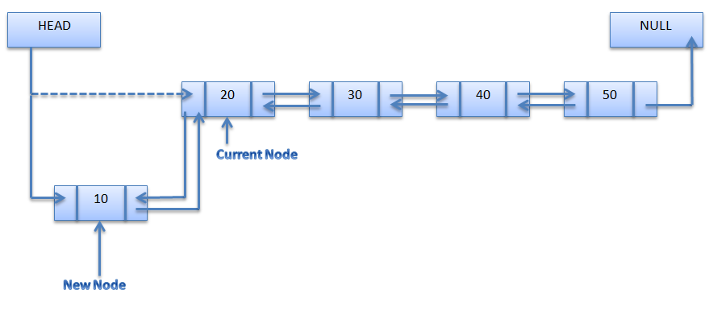
Operations On doubly linked List

Slide 11
Operations On doubly linked List
Inserting at the end of the list
To insert an element at the end of the list, first we test whether the linked list is initially empty. If yes, then the element is inserted as the first and only element of the list by performing the following steps:
Assign Null value to the nextpointer and previospointer field of the new node.
Assign address of the new node to head and tail pointer variables.
However, if the list is initially not empty, then the element is inserted as the last element of the list by performing the following steps:
Assign Null value to the nextpointer field of the new node.
Assign value of the tail variable to the previouspointer field of the new node.
Assign address of the new node to the nextpointer field of the node currently pointed by tail variable.
Finally, assign the address of the new node to node tail variable as in the figure in the next slide.

Slide 12
Operations On doubly linked List

Slide 13
Operations On doubly linked List
Deleting an element from linked list.
To delete an element from the list first the pointers are set properly and then the memory occupied by the node to be deleted is de-allocated (freed).
The deletion in the list can take place at the following positions:
At the beginning of the list.
At the end of the list.

Slide 14
Operations On doubly linked List
Deleting from the beginning of the list .
An element from the beginning of the list can be deleted by performing following steps:
Assign the value of head to a temporary variable ptr.
Further, there are two cases:
If there is only one element in the existing list, both head and tail variable are set to NULL.
If there are more than one element in the list, then following steps given below:
Assign NULL value to the previouspointer field of the second node.
Assign address of the second node to head.
De-allocate the memory occupied by the node pointed to by ptr.

Slide 15
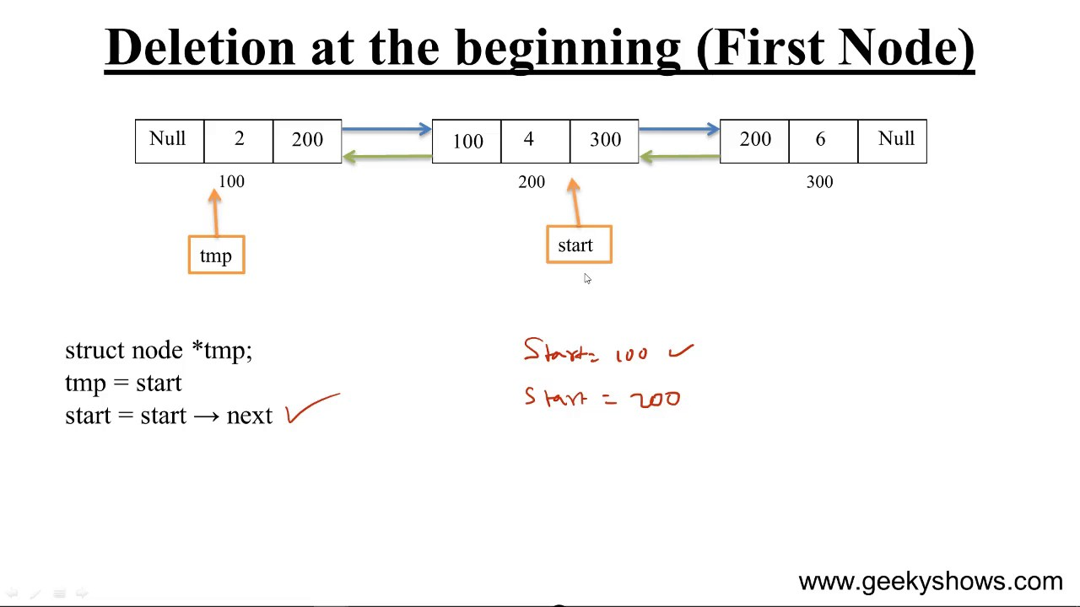
Operations On doubly linked List

Slide 16
Operations On doubly linked List
Deleting from the end of the list
An element from the end of the list can be deleted by performing following steps:
Assign the value of tail to a temporary variable ptr. Further, there are two cases:
If there is only one element in the existing list, both head and tail variable are set to NULL.
If there are more than one element in the list, then following steps given below:
Assign NULL value to the nextpointer field of the last node.
Assign address of the second last node to tail.
De-allocate the memory occupied by the node pointed to by ptr.

Slide 17
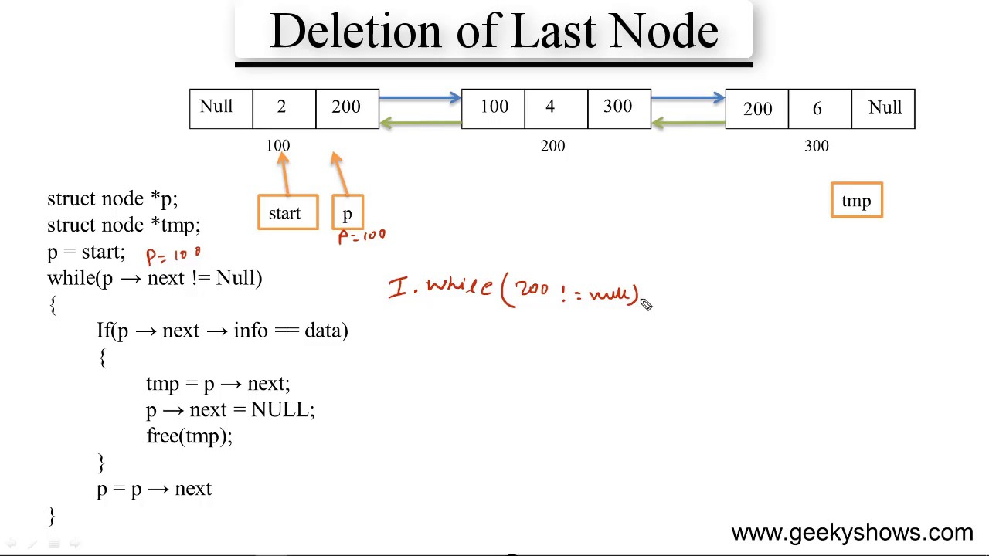
Operations On doubly linked List

Slide 18

THANK YOU

